Slide 1
Formal Methods in the Software Industry
Johannes Kanig
AdaCore
Notes:
Agenda:
Introduce formal methods
State of the art in the past
How some newer trends advance the state of the art

Slide 2
AdaCore
Short presentation of the Company
Founded in 1994
Main products
All products are Open Source
Main offices in Paris and New York
~100 employees today
Over 500 customers world wide
Compiler(s) for the Ada language
Development tools
Static Analysis/Formal Verification tools
Subscription model
Engineers directly provide support

Slide 3
6
3
1
2
5
75+
50+
9
100+
7
100+
6
4
1
2
1
4
Over 500 customers
worldwide
6

Slide 4
About me (Johannes Kanig)
PhD from Université Paris Sud in Formal verification
Joined AdaCore in 2011
Working on Formal verification tool SPARK

Slide 5
What are formal methods
“Formal methods” are the use of mathematical techniques in the design and analysis of computer hardware and software; in particular, formal methods allow properties of a computer system to be predicted from a mathematical model of the system by a process akin to calculation. […]
Formal methods confront the discrete behavior of computer systems by using discrete mathematics to model it.
John Rushby, Formal Methods and the Certification of Critical Systems (1993)

Slide 6
The promise of formal methods (1)
It is a deplorable consequence of the lack of influence of mathematical thinking on the way in which computer programming is currently being pursued, that the regular use of systematic proof procedures, or even the realization that such proof procedures exist, is unknown to the large majority of programmers. Undoubtedly, this fact accounts for at least a large share of the unreliability and the attendant lack of over-all effectiveness of programs as they are used today.
Peter Naur, Proof of algorithms by general snapshots, 1966
Notes:
Dijkstra quote “Testing shows the presence, not the absence, of bugs”

Slide 7
Why use them to develop Software
In some systems, software bugs can have a disastrous impact
Safety critical software
Security-related software
Often embedded software
Strive for more quality in regular software
Find more bugs than regular testing would do
Notes:
Space code: write code that will run several years later, only once, and if there is a bug destroys the entire mission
Example: ESA Schiaparelli

Slide 8
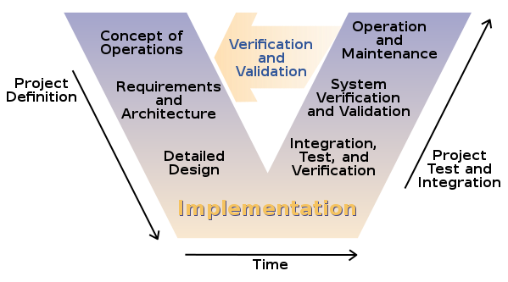
Traditional software development process
Standard process in safety-critical industry
Other industries follow more informal process with little design

Slide 9
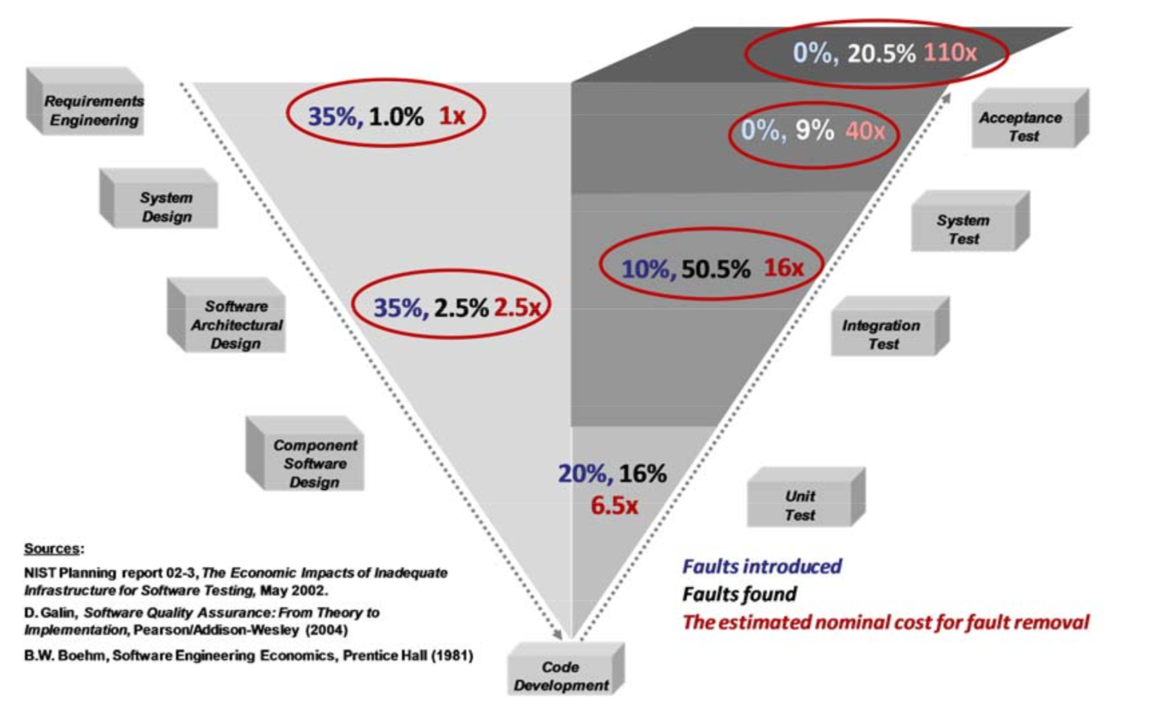
The promise of formal methods
Number of faults introduced
Percentage of faults fixed
Cost of repair
Feiler et al, Reliability Validation and Improvement Framework, 2012
Notes:
Promise of formal methods: reduce overall cost of software

Slide 10
Formal Methods for Requirements
How: Write requirements in a formal language instead of in English
Benefits:
Homogenize use of terms
Remove ambiguity
Detect “typing” issues
Detect conflicting requirements (model checking)
Prove high-level properties of the system

Slide 11
Formal Methods for code
Code without any extra annotations
Finding bugs: runtime errors, logical errors, suspicious code, dead code
Prove absence of runtime errors
But usually high number of false positives
Code with extra annotations
Prove absence of runtime errors
Prove correctness wrt. Requirements

Slide 12
Formal Methods for Testing
Test case generation from code or requirements

Slide 13
Soundness vs Unsoundness
A sound tool finds all problems of a given type (e.g. all arithmetic overflows)
But usually also report some false alarms
A complete tool would have no false alarms (almost no such tools exist)
Unsound tools also exist
Common choice: Only show issues that are real problems with high probability
Notes:
Maybe surprising at first to have an unsound tool based on FM!
But very useful in practice

Slide 14
State of the art 1993
John Rushby, Formal Methods and the Certification of Critical Systems (1993)
Mentions many smaller-sized projects that used formal methods
Mostly used a formal language at the Requirements level
All in safety-critical environment

Slide 15
State of the art 2008 (1)
Woodcock et al: Verification and Formal Methods: Practice and Experience (2008)
Surveys 48 industrial projects that used formal methods
Mostly safety-critical/security projects
Some examples
Paris Line 14 automated subway train – using B
Multos smart card OS - using SPARK
Tokeneer – access control application written SPARK
Felica – smart card system, using VDM as specification language, implementation in C++

Slide 16
State of the arts 2008 (2)
Some off-the-shelf bug-finder tools:
Mathworks Polyspace
Synopsis Coverity
GrammaTech CodeSonar
Astrée verifier
Inhouse tool Prefix at Microsoft
Checks API use of drivers
Issues with these tools:
Slow (require overnight or even over-weekend runs)
Often require entire program to analyse (need main program)
Many false positives that need to be checked by engineers
Notes:
Expand on false positives: false alarms
Require a lot of time for inspection
Reduce trust in the tool

Slide 17
Challenges of FM at the code level
Usability
Are tool results presented so that they are easily understood?
False positives?
Analysis speed?
Scalability
Can the tool be applied to large projects (millions of lines of code, hundreds of developers)?
Are enough people with the required expertise available? How much training required?
Cost/Benefit argument
Formal methods usually is some extra activity during development
Is this extra activity expensive? Does it save cost later?
Notes:
These challenges are overlapping
Problem that avoided cost is invisible

Slide 18
Challenges of FM for requirements
Scalability not a very big issue
diversity of domains
Domain-specific terms and knowledge required
diversity of problems
Properties depend on time
Protocol verification
Interaction with outside environment

Slide 19
Case study: Facebook’s Infer (1)
2009 Monodoics develops the first version of Infer
2013 Facebook acquires Monodoics
What the tool can do:
Find null-pointer exceptions, resource leaks, concurrency race conditions in unannotated source code
ROFL Episode (Report only Failure List):
Overnight runs
Manual inspection of messages, create tickets for developers
Almost no reaction by developers
Peter O’Hearn - Continuous Reasoning (2018)
Notes:
Bug-finding tool, runs on non-annotated code

Slide 20
Case study: Facebook’s Infer (2)
Scalability
Improved the tool to be able analyze small pieces of code (mostly) independent of other code
Tool can run on changed code only, report new issues only
Usability
Integration into code reviews instead of bug reports
Very low false positive rate
At the cost of less found bugs
Result: Fix rate of reported issues raised to 70%
Notes:
Explain the notion of “review area”

Slide 21
Newer generation of Bug-finders
Find bugs in large codebases
Deal with large number of developers checking in new code
Emphasis on quick feedback, very low false-positive rate
Examples
Facebook Infer
Google Tricorder framework
Microsoft Prefast (faster successor of prefix)
AdaCore lightweight checkers
Advanced linters in widespread use
Cpp-check, Clang-analyzer, PVS-studio

Slide 22
Amazon
CHRIS NEWCOMBE et al: How Amazon Web Services Uses Formal Methods
Use of TLA+ to find bugs in (abstractions of) concurrent programs
Proved full correctness of a small crypto library
Notes:
TODO fix these slides

Slide 23
Case study: SPARK (1)
Provable subset of the Ada programming language
Program text is enriched with pre/postconditions and other annotations
Allows to prove correctness of code wrt requirements
1987~2008 Developed initially by researchers, then by Praxis/Altran
Since 2008 AdaCore joined the development of SPARK
Some industrial projects used SPARK at that time, but no big demand
Issues:
Users need to learn annotation language in addition to programming language
Tiny acceptable subset of Ada
Many true properties not proved (false alarms)
All-Or-Nothing – difficult to deal with code outside the SPARK subset, or unproved code

Slide 24

IFACTS project
Software for air traffic control of UK air space
Large application (~200k lines of code)
Proof of absence of runtime errors, some functional properties
Requirements expressed in Z formal notation

Slide 25
Case study: SPARK (2)
Scalability:
Modern algorithms to deal with large programs
Usability:
Much larger subset of Ada – in fact almost all of Ada
Annotation language is the same as programming language
Extra annotations are just code – like assertions
No new language to learn
Exact same semantics of proof vs execution
Much better provability thanks to SMT solvers
Failed proofs explained, e.g. using counter examples
Tools integrated in the IDE
Cost/Benefit
incremental benefits, expressed in terms of objectives:
No access to uninitialized data; no runtime errors; prove of properties
Proof can be applied to part of code only, interface with testing

Slide 26
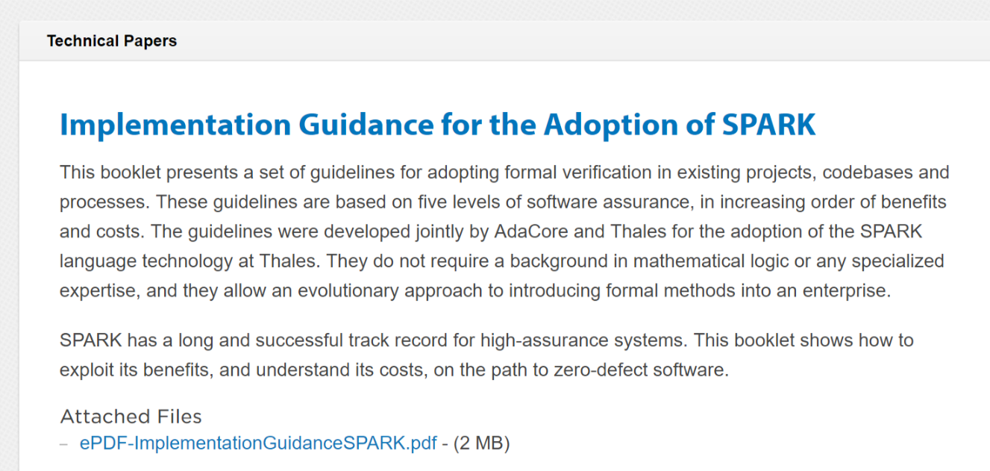
SPARK Adoption guide by Thales
From http://www.adacore.com/knowledge/technical-papers/implementation-guidance-spark/

Slide 27
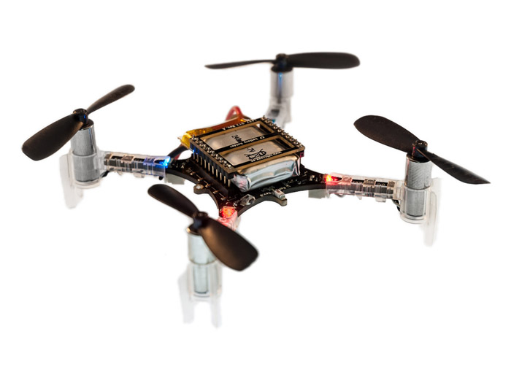
Crazyflie 2.0
1800 sloc stabilization in C
+ FreeRTOS
+ …
Notes:
But before that, here is a story that supports my bold claim.
This is the Crazyflie, a small leisure drone, originally programmed in C on top of FreeRTOS + libraries/drivers/etc all in C.

Slide 28
2 months later…
Crazyflie 2.0
1800 sloc stabilization in C
+ FreeRTOS
+ …
Crazyflie in Ada/SPARK
2100 sloc stabilization in SPARK
proved no run-time errors!
+ FreeRTOS
+ …
Notes:
Here is our past intern Anthony Leonardo Gracio.
Anthony had little knowledge of Ada and no knowledge of SPARK or of any static analysis tools prior to his internship.
Yet, in 2 months, Anthony rewrote completely the stabilization code of the Crazyflie in SPARK, and he proved absence of run-time errors on the SPARK code.
And the drone was flying better at this stage.

Slide 29
5 months later…
Crazyflie 2.0
1800 sloc stabilization in C
+ FreeRTOS
+ …
Crazyflie in Ada/SPARK
2100 sloc stabilization in SPARK
proved no run-time errors!
+ using Ada tasking system instead of RTOS
Proved no concurrency errors!
Notes:
Just give him 3 more months, and he rewrote the complete firmware in SPARK and Ada.
And now we expect to prove absence of concurrency errors with the upcoming version of SPARK that supports Ravenscar (safe tasking in Ada)
Anthony’s assessment of using SPARK was that it was intuitive! Not the typical feedback from people who use formal methods tools for the first time.
You’ll see a demo of the Crazyflie in the next talk btw.

Slide 30
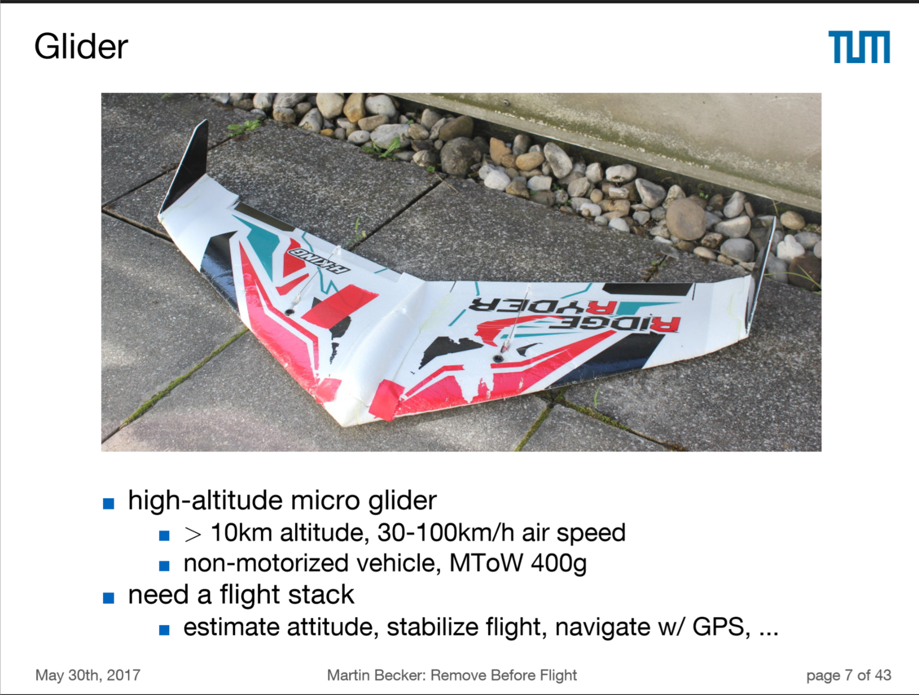
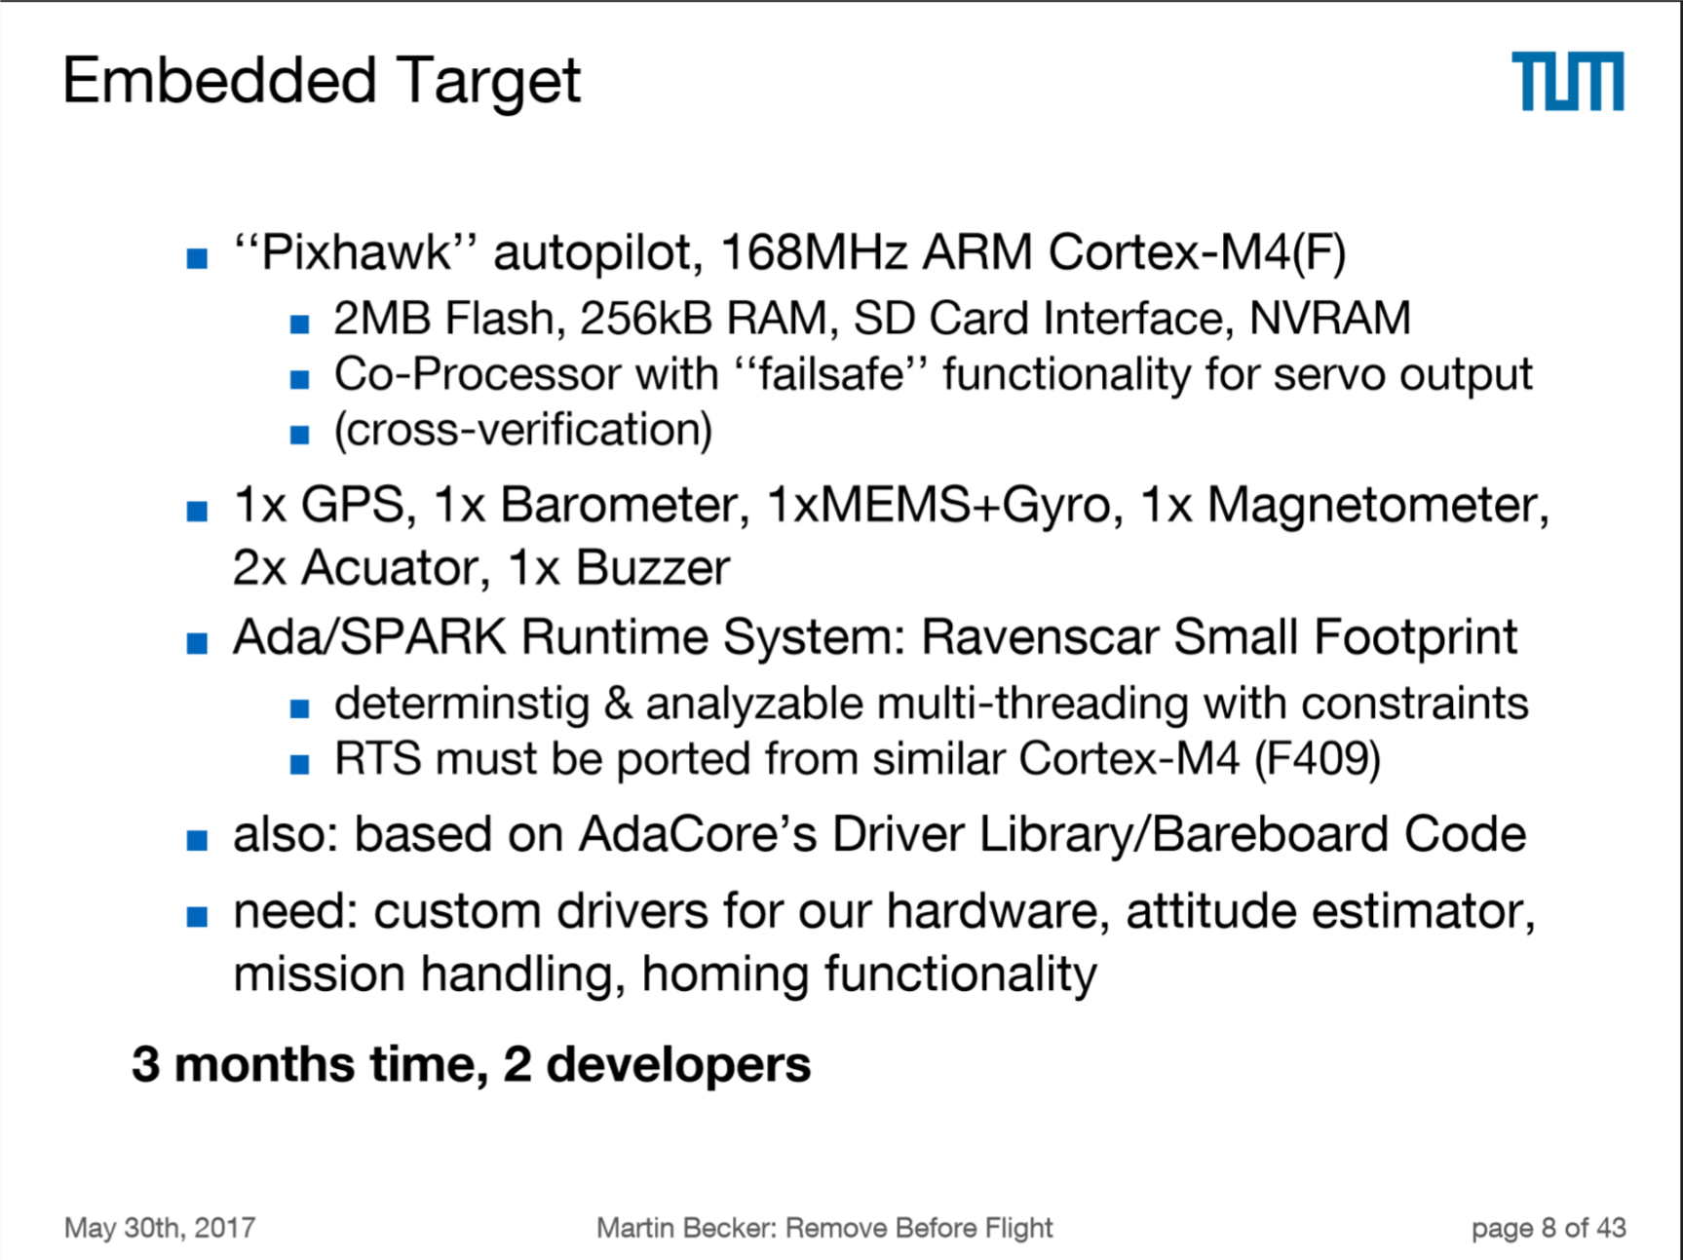
Martin Becker, TU Munich

Slide 31
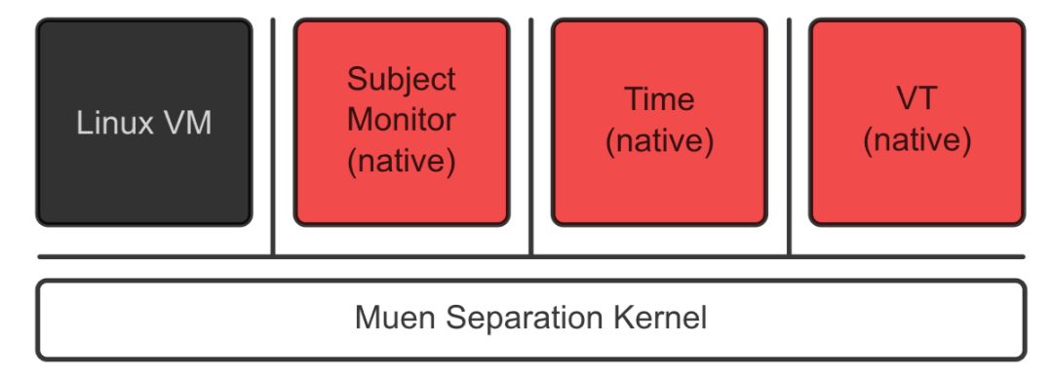
Muen Separation kernel
Very small kernel to allow separation between guest OS
Proof of absence of runtime errors, some functional properties
Just 2 main developers (master level students at the start of the project)

Slide 32
Conclusion
Formal methods now finally used on a daily basis on large codebases
But mostly for bug-finding
Program proof still anecdotical, but slow progress (SPARK)
Absence of runtime errors is an easy target nowadays
Formal methods for requirements also anecdotical, no clear winning tool or method
But some nice success stories (e.g. Amazon)

